Slide 1
Introduction to Unity
CaramelYo

Slide 2
Outline
Last Class
Multiple Scenes
Animator
Navigation
Future
Notice
Notes:
Import “Raw Mocap Data”

Slide 3
Outline
Last Class

Slide 4
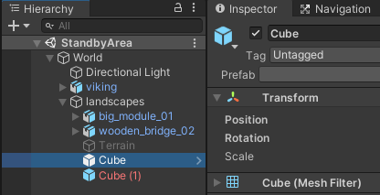
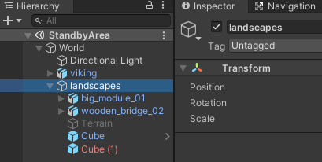
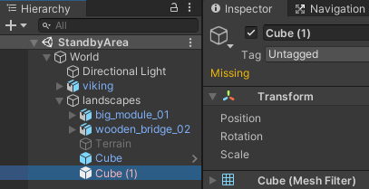
Prefab
Prefab Asset and (Prefab) instance
The text of Prefab instance is blue
The text of Prefab instance missing the connection to its Prefab Asset is red
The text of others is white
Notes:
人與人之間的連結

Slide 5
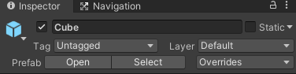
Prefab
Prefab instance behavior
Open
Open its Prefab Asset (with Prefab Mode)
Select
Show its Prefab Asset in Project window
Notes:
講這麼多 prefab ，是為了甚麼 ?? 有甚麼好處 ??

Slide 6
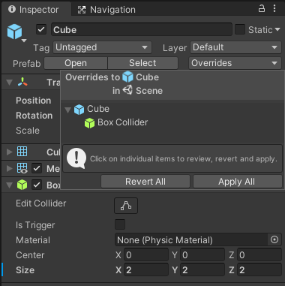
Prefab
Prefab instance behavior
Overrides
Look over the differences between this instance and its Prefab Asset
“Revert All” would revert most of its states back to its Prefab Asset
“Apply All” would apply most of its overridden states to its Prefab Asset
※ Once Prefab Asset changes, all its Prefab instances would change at the same time
※ An overridden state on a Prefab instance always takes precedence over the value from the Prefab Asset
Overridden property
Notes:
An overridden property value on a Prefab instance always takes precedence over the value from the Prefab Asset.
Overriding the value of a property
Adding a component
Removing a component
Adding a child GameObject
例外：該 instance 的 prefab 是 model prefab 時，無法使用 apply

Slide 7
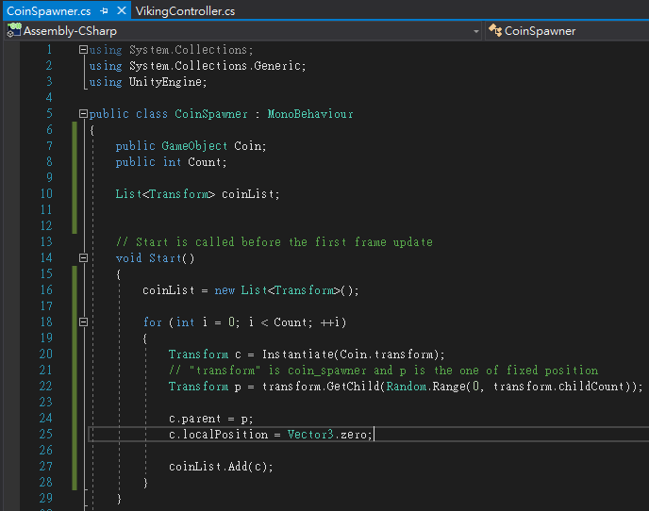
Prefab
“instantiate” Prefab instance in run time
Coin spawner

Slide 8
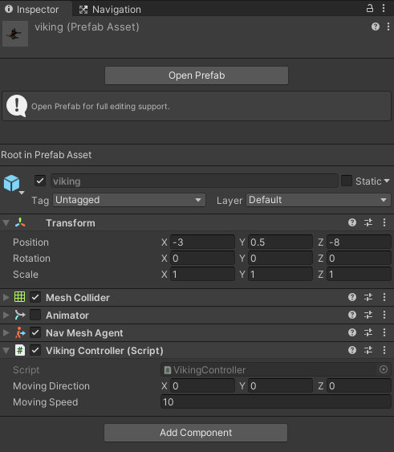
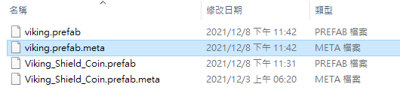
Prefab
Meta file
A file to save the unity states

Slide 9
Physics
The two most important components in physics engine
Rigidbody
Turn a GameObject into rigid body so that it can do some physical behavior
Add force, modify velocity, gravity and so on.
Collider
Give a GameObject a region (called collider) to calculate collision detection and trigger detection
Basic collider：box collider, sphere collider and capsule collider
Advanced collider：mesh collider
Notes:
Rigid body 剛體

Slide 10
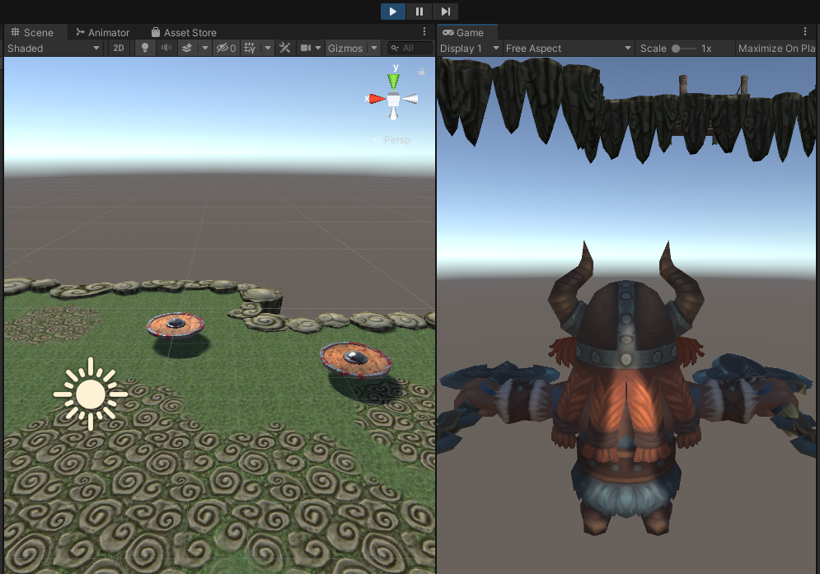
Physics
Rigidbody
Gameplay…
Viking would fall due to gravity

Slide 11
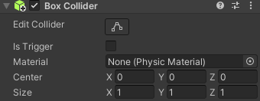
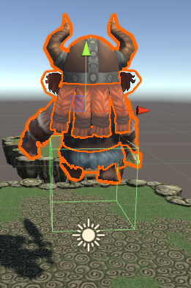
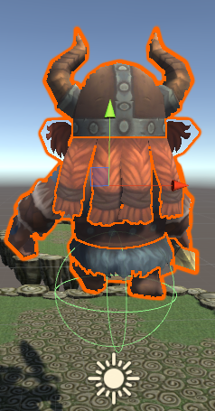
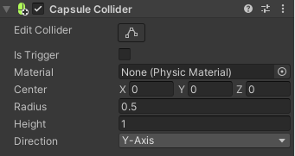
Physics
Collider

Slide 12
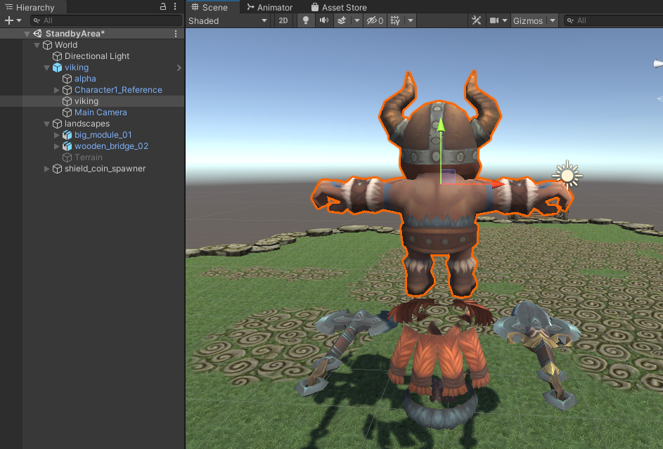
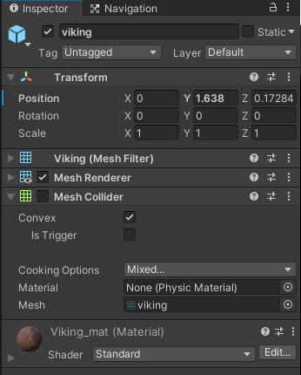
Physics
※ Mesh Collider
Find the main mesh renderer of your model

Slide 13
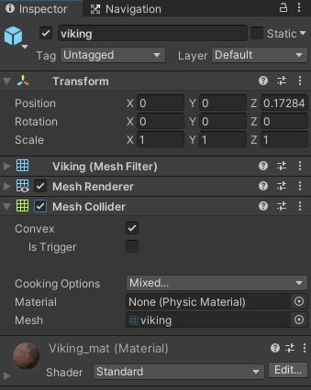
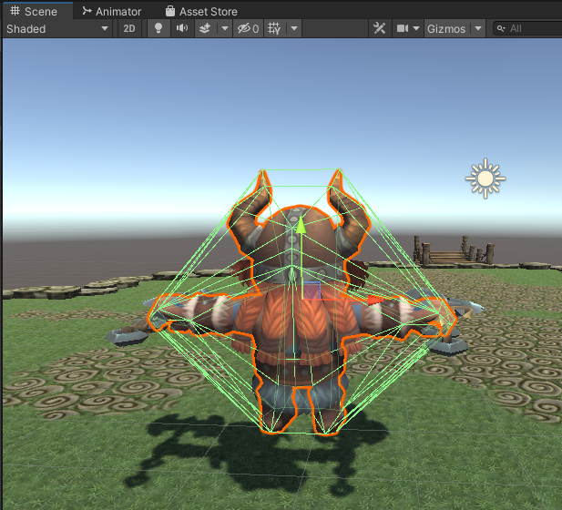
Physics
※ Mesh Collider
Mesh collider setting

Slide 14
Physics
※ Mesh Collider
Advantage
Intuitive
Easy to fit (no need to fit)
Disadvantage
High-resource cost
unstable

Slide 15
Physics
Collision
OnCollisionExit
End of collision
Collision ends
Collision occurs
OnCollisionEnter
OnCollisionStay
During collision
During collision

Slide 16
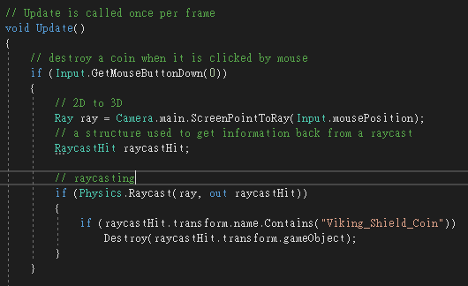
Physics
Raycasting
Destroy a coin when it is clicked by mouse

Slide 17
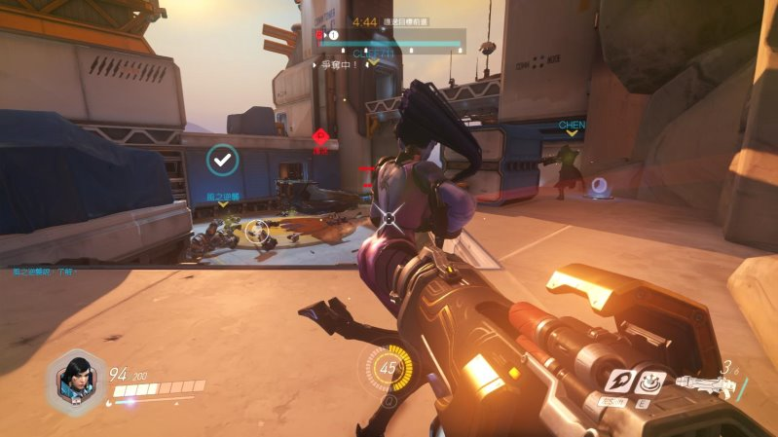

Physics
What else can ray do ?
Notes:
鬥陣特攻隊沒人在玩了??

Slide 18
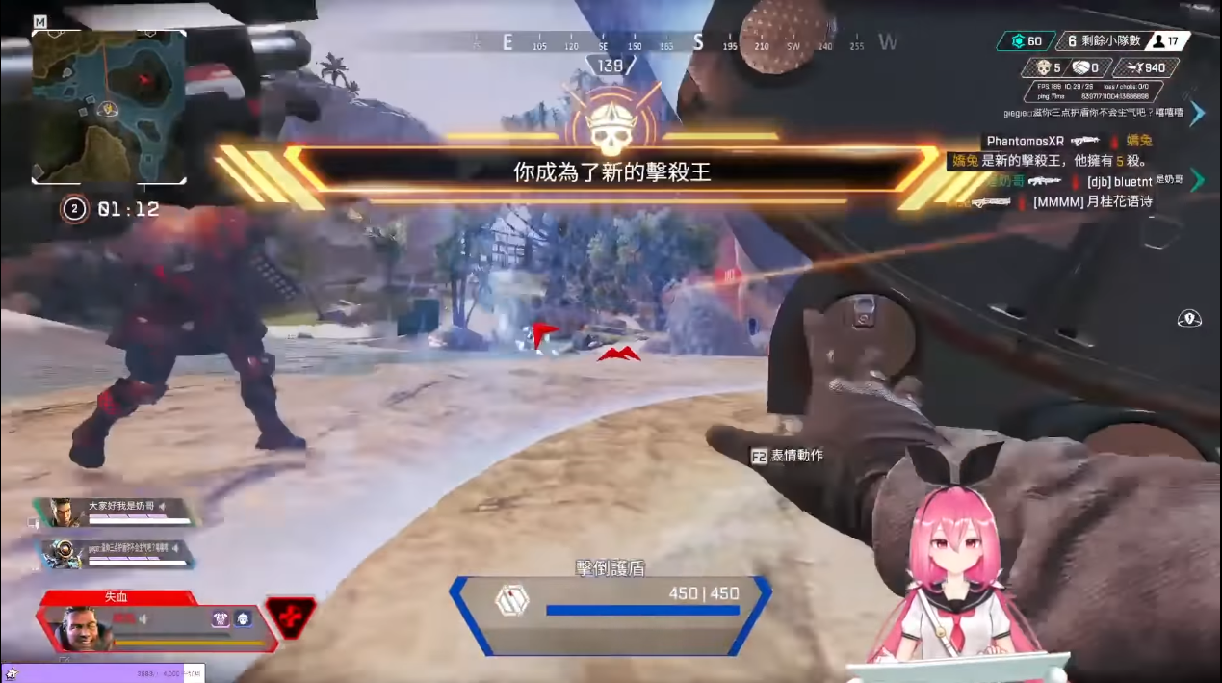
Physics
What else can ray do ?
Notes:
Apex 總知道了吧

Slide 19
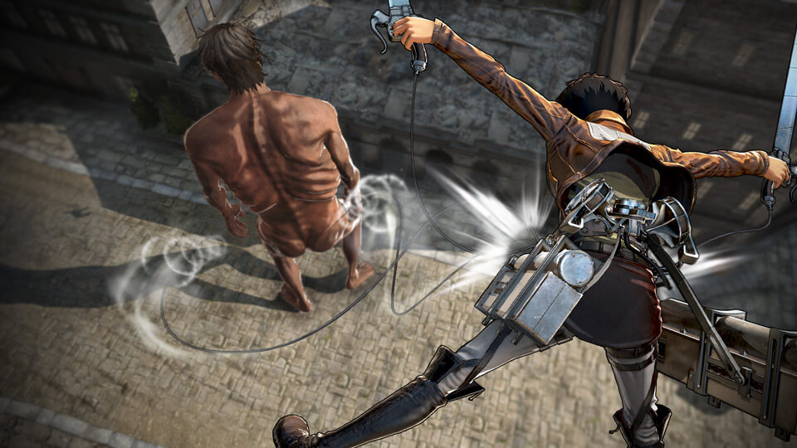
Physics
What else can ray do ?
Notes:
巨人過氣了 ??

Slide 20
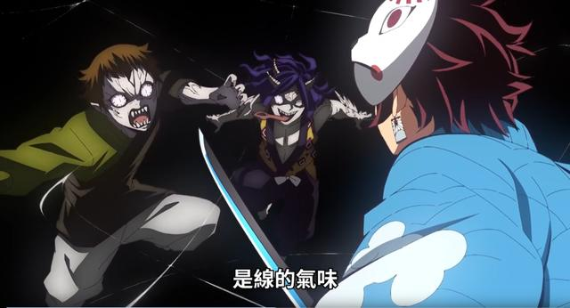
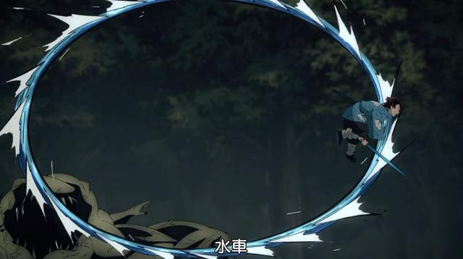
Physics
What else can ray do ?
Notes:
鬼滅的隙之線知道吧

Slide 21
Outline
Multiple Scenes

Slide 22
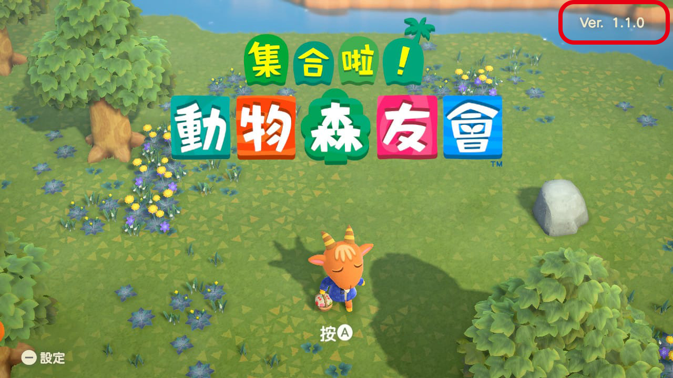

Multiple Scenes
Menu

Slide 23
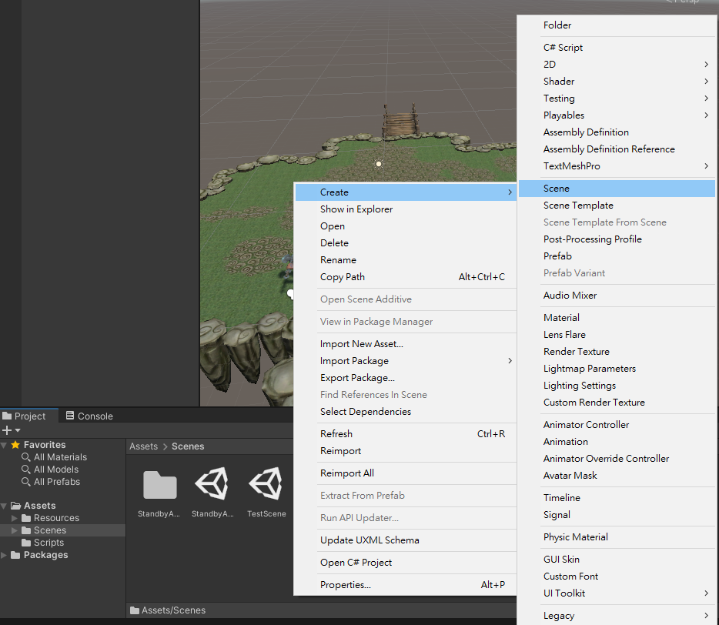
Multiple Scenes
Create a new scene

Slide 24
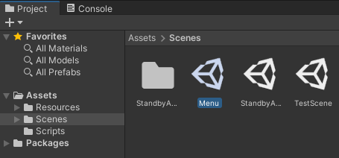
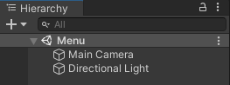
Multiple Scenes
Create a new scene

Slide 25
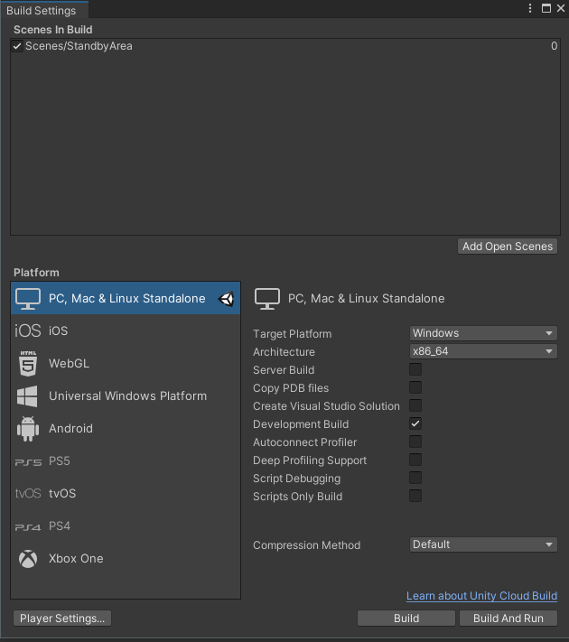
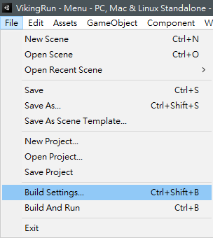
Multiple Scenes
Build Settings
Add this scene to build settings
Click to add the active(current) scene

Slide 26
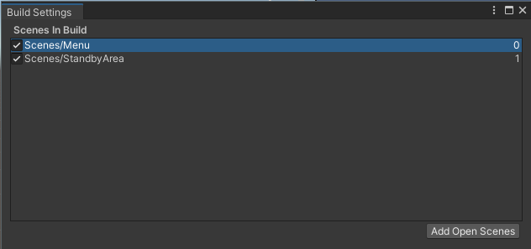
Multiple Scenes
Build Settings
Add this scene to build settings
Activate “Menu”
Scene index
Drag to switch the scene index

Slide 27
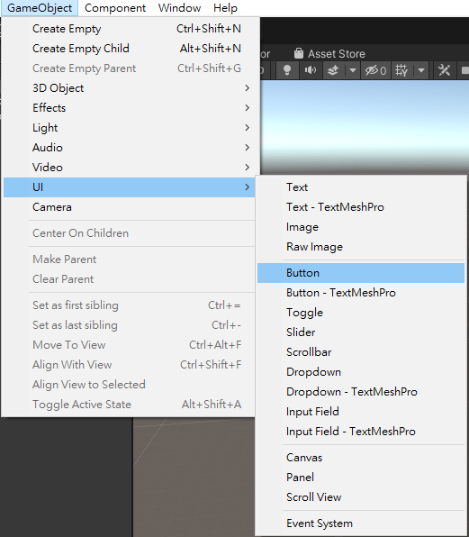
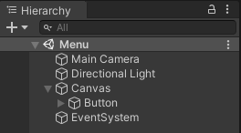
Multiple Scenes
Design 2D Menu
Create a (UI) button

Slide 28
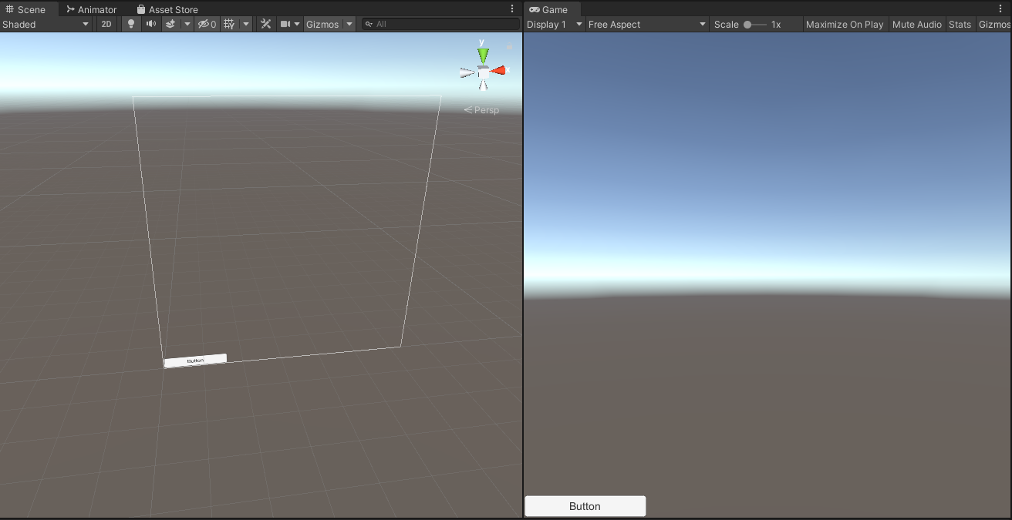
Multiple Scenes
Design 2D Menu
Canvas

Slide 29
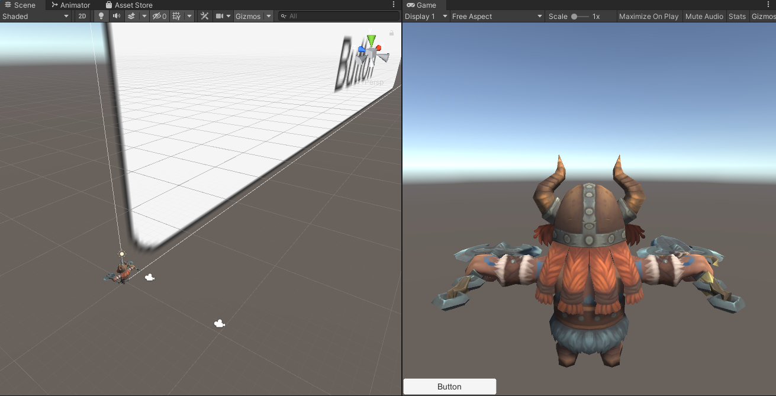
Multiple Scenes
Design 2D Menu
Canvas is usually rendered to your screen directly
Notes:
提一下 canvas 的概念 Canvas mix 2D & 3D

Slide 30
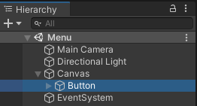
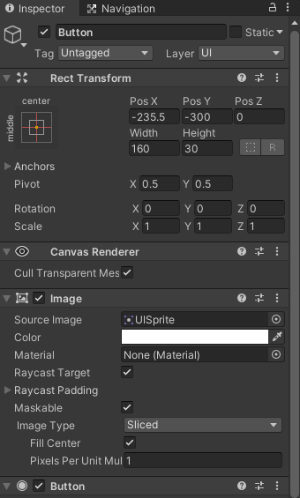
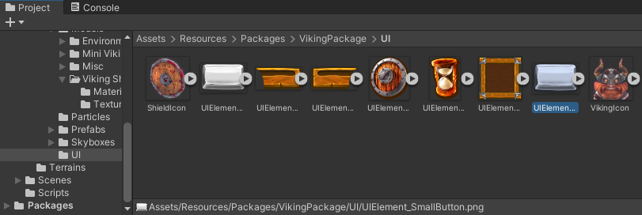
Multiple Scenes
Design 2D Menu
Change button image

Slide 31
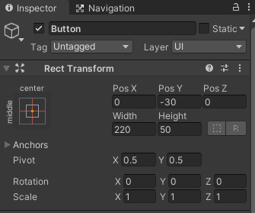
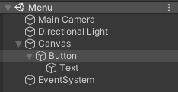
Multiple Scenes
Design 2D Menu
Adjust button and its text

Slide 32
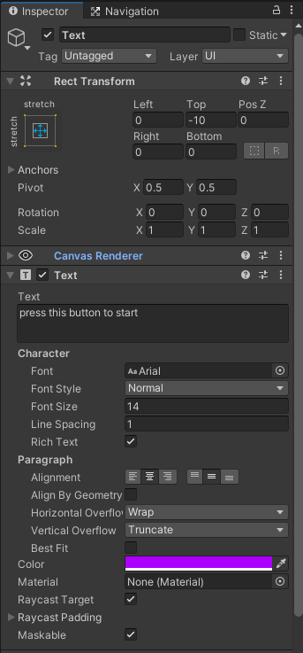
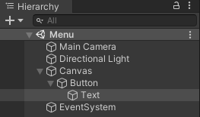
Multiple Scenes
Design 2D Menu
Adjust button and its text

Slide 33
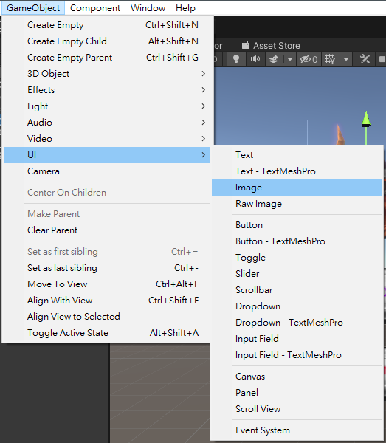
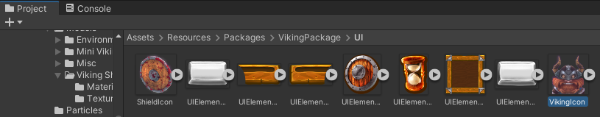
Multiple Scenes
Design 2D Menu
UI image

Slide 34
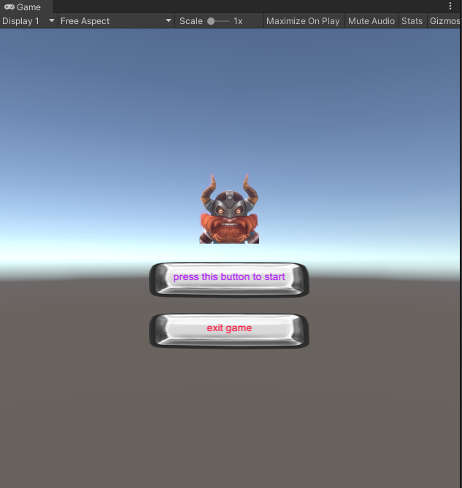
Multiple Scenes
Design 2D Menu
Menu is completed

Slide 35
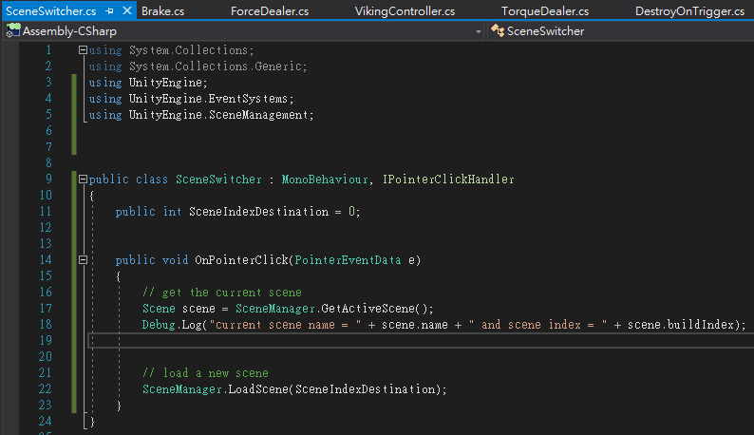
Multiple Scenes
Scene manager
Scene switcher
To use the “SceneManager”
To use “IPointerClickHandler”
interface
UI button click interface
UI button click event
Switch to the scene index

Slide 36
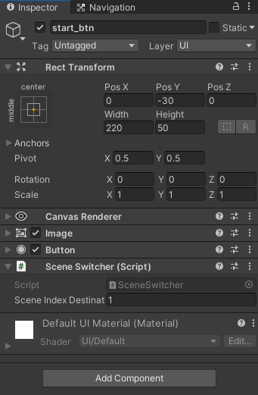
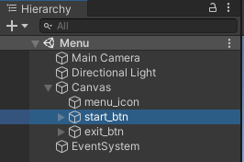
Multiple Scenes
Scene manager
Scene switcher

Slide 37
Multiple Scenes
Scene manager
When you switch to other scene, those GameObject in the current scene would be destroyed
If you want to preserve some GameObjects, please use “DontDestroyOnLoad”

Slide 38
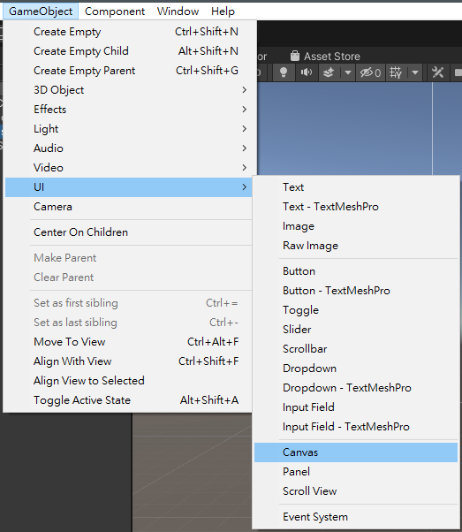
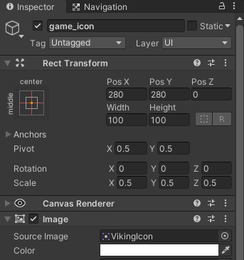
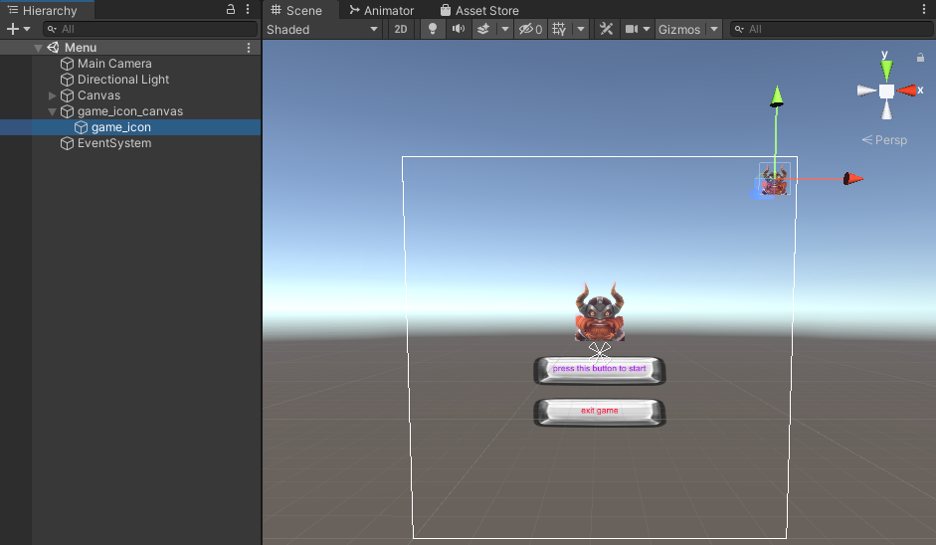
Multiple Scenes
Scene manager
Create a new game icon in a new canvas
Notes:
Canvas mix 2D & 3D

Slide 39



Multiple Scenes
Scene manager
“DontDestroyOnLoad”
Notes:
Canvas mix 2D & 3D

Slide 40

Multiple Scenes
Scene manager
“DontDestroyOnLoad”
Notes:
Canvas mix 2D & 3D

Slide 41



Multiple Scenes
Scene manager
Exit button
It wouldn’t happen in gameplay in unity editor mode

Slide 42
Practices
Create a new scene as your game menu
A button to switch to your game scene
A button to exit game (application)

Slide 43


Multiple Scenes
※ Lighting
If your scene get darker when a scene switches to another scene, that’s fine
It occurs only in gameplay in unity editor mode

Slide 44



Multiple Scenes
※ Lighting
For more details, please reference this

Slide 45


Multiple Scenes
※ Lighting
For more details, please reference this

Slide 46





Multiple Scenes
Why doesn’t Pokemon Go design a menu only ??
Why do we need Menu ??
Notes:
為什麼大部分的遊戲都有 menu ，但 pokemon go 卻沒有 ??
為什麼像動森，最一開始點擊時就直接跳到教學頁面而沒進 menu ??

Slide 47


Multiple Scenes
※ Merge your practice and homework
Copy it!

Slide 48


Multiple Scenes
※ Merge your practice and homework
The same name of the scripts will cause error!
Copy it!

Slide 49




Multiple Scenes
※ Merge your practice and homework
Change both the script name and class name

Slide 50
Outline
Animator

Slide 51


Animator
炎姬
炎姬_宣傳

Slide 52

Animator
炎姬
炎姬_宣傳

Slide 53


Animator
Animator controller
Create an Animator

Slide 54

Animator
Animator controller
Open an Animator
State machine
Double click

Slide 55
Animator
Animator controller
Entry：entry point of animator (state machine)

Slide 56

Animator
Animator controller
Add a new state

Slide 57


Animator
Animator controller
Add a new state

Slide 58


Animator
Rename states
Rename the first state “Idle”
Create another state and rename it as “Run”

Slide 59


Animator
Download animation from Asset Store
Open “Asset Store” tab (obsolete)

Slide 60

Animator
Download animation from Asset Store
Asset Store web

Slide 61

Animator
Download animation from Asset Store
Asset Store web

Slide 62



Animator
Download animation from Asset Store

Slide 63

Animator
Download animation from Asset Store

Slide 64



Animator

Slide 65




Animator
Download animation from Asset Store
Completed！

Slide 66



Animator
Avatar
Rigging
No avatar
Avatar!

Slide 67


Animator
Avatar
Assign the avatar

Slide 68


Animator
Idle animation
Select an animation as idle
Preview

Slide 69

Animator
Idle animation
Assign the idle animation

Slide 70


Animator
Idle animation
Animator component

Slide 71


Animator
Idle animation
Animator component

Slide 72


Animator
Idle animation
Gameplay…
The Prefab Asset (instance) has been disconnected from the Model Prefab
Notes:
Model 本身的 avatar 並沒有套用上

Slide 73

Animator
Idle animation
Remake your Viking…
※ Prefab Variant

Slide 74
Practices
Set an animator to your Viking
Idle animation

Slide 75


Animator
※ Idle animation
Mesh collider ??

Slide 76


Animator
Idle and run animation
Make transition

Slide 77


Animator
Idle and run animation
Add a new animator variable

Slide 78


Animator
Idle and run animation
Transition arrow
Transition condition

Slide 79

Animator
Idle and run animation
When those conditions are true, then the current state(Idle) will transit to the next state(Run)

Slide 80


Animator
Idle and run animation
Transition arrow
Transition condition

Slide 81



Animator
Idle and run animation
Assign the run animation

Slide 82



Animator
Idle and run animation
Coding to control “Run”

Slide 83

Animator
Idle and run animation

Slide 84
Practices
Set an animator to your Viking
Idle animation
Run animation
Idle ⬄ run

Slide 85


Animator
※ Rigging
Switch to Rig!
Choose “Humaoid”
“X” => failed rigging!
Click “Configure”
“V” => successful rigging

Slide 86

Animator
※ Rigging
Successful rigging

Slide 87

Animator
※ Rigging
Failed rigging
Problem!!
Click!

Slide 88

Animator
※ Rigging
Failed rigging
Required!

Slide 89


Animator
※ Rigging
Failed rigging
Drag!

Slide 90

Animator
※ Rigging
Successful rigging
Click “Apply” and then click “Done”!

Slide 91

Animator
Idle and run animation
Exit a state at any time

Slide 92

Animator
Idle and run animation
Disable the translation of animation
Deactivate

Slide 93
Outline
Navigation

Slide 94


Navigation
Path-finding system

Slide 95

Navigation
Path-finding system
*
Notes:
A* algorithm

Slide 96

Navigation
Navigation
Navigation Static
Off Mesh Link Generation
Tell AI where they can walk

Slide 97




Navigation
Navigation
Tell AI where they can walk

Slide 98
Navigation
Navigation
Do the same thing on all grounds

Slide 99


Navigation
Navigation
Navigation window

Slide 100


Navigation
Navigation
The cyan-blue region is walkable
Trigger “Gizmos” and “Show NavMesh” to true state

Slide 101

Navigation
Navigation
Add agent component to Viking

Slide 102


Navigation
Navigation
Viking would move to the point mouse clicked by Nav agent
Comment the original moving behavior
Comment the original mouse behavior

Slide 103





Navigation
※ Navigation with animation
Get the agent next point and calculate the delta position
Set animator parameters

Slide 104
Outline
Future

Slide 105
Future
Unity V.S. Unreal engine
In my opinion
 | Unity | Unreal engine
Learning curve | Easy | Hard
UI / X | Good | Normal
Development cycle (for most case) | Fast | Slow
Cost | Low | High
Cross-platform | Many | Normal
Language | C# / JavaScript | C++

Slide 106

Future
Unity V.S. Unreal engine
For more details, please reference to this web and this video

Slide 107

Future
Cross-platform、versatility

Slide 108

Future
AR、MR(XR)
For more details, please reference to this

Slide 109

Future
AR、MR(XR)
For more details, please reference to this

Slide 110
Outline
Notice

Slide 111



Notice
Please upload your homework including those files outputted from unity

Slide 112


Outline
Thank you for your listening!

Slide 113
Outline
※ Terrain

Slide 114

Terrain
Terrain in Unity

Slide 115



Terrain
Terrain in Unity

Slide 116

Terrain
Terrain in Unity

Slide 117


Terrain
Terrain
Setting
Width：50 Height：50

Slide 118



Terrain
Choose “Paint” tool
Terrain
Paint
Choose a mode
Raise or Lower Terrain mode

Slide 119


Terrain
Terrain
Paint
Other modes

Slide 120
Terrain
Asset store web
Open “Asset Store” tab (obsolete)

Slide 121
Terrain
Asset store web
https://assetstore.unity.com/

Slide 122



Terrain
Asset store web

Slide 123

Terrain
Asset store web

Slide 124



Terrain

Slide 125



Terrain
Asset store web
Completed！

Slide 126



Terrain
Terrain
Paint
Paint Texture modes

Slide 127

Terrain
Terrain
Paint
Paint Texture modes

Slide 128


Terrain
Terrain
Paint
Paint Texture modes
Add other layers
Use them by brushes

Slide 129


Terrain
Asset store web

Slide 130

Terrain
Asset store web

Slide 131

Terrain

Slide 132



Terrain
Asset store web
Completed！

Slide 133


Terrain
Terrain
Paint
Paint Trees modes

Slide 134


Terrain
Terrain
Paint
Paint Trees modes
Add trees by brushes

Slide 135


Terrain
Terrain
Paint
Paint Details modes

Slide 136


Terrain
Terrain
Paint
Paint Details modes

Slide 137


Terrain
Terrain
Paint
Paint Details modes
Add grass by brushes

Slide 138

Terrain
Terrain
Completed！
Play！

Slide 139
Practice
Terrain
Try to create your terrain！

Slide 140

Download Free Modules
Download free unity model
https://free3d.com/3d-models/unity

